Slide 1
Legal Literacy in Juvenile and Juvenile Crime Rates
Mini Project Presentation – Mai Nguyen

Slide 2
Agenda
1. Motivation
2. Data
3. Data Visualization
4. Implications

Slide 3
MOTIVATION
“Knowledge of the laws allows the child not only to refrain from illegal acts, but also not to become a victim of violence and deceit” - UNICEF
Legal education in schools should go beyond simply obeying rules or protesting laws; it should teach students about the legal process, reasoning skills, and civic participation to create engaged citizens.
By teaching students about the legal process and the consequences of illegal activities, legal education can deter them from participating in criminal acts, leading to a reduction in juvenile crime rates.
Current Problem

Slide 4
Variables of Interest
Dependent Variable
Independent Variable
Juvenile Crime Rates
Juveniles’ Civics Scores at school
IV
IV
Demographic information, household information
Socioeconomic Factors, Law Enforcement Policies.

Slide 5
Data
 | Source | Basic Info | Visualization
Juvenile Crime Rate | - State-Level Data on Juvenile Delinquency and Violence - Department of Justice; publisher National Institute of Justice | - Being requested
Civics Score | - The NAEP Data Explorer provided by the Nation’s Report Card https://shorturl.at/ruGWX | - National and state results for civics in 3 grades: 4,8, and 12 - Timeframe: 1998-2010 | See Figure 1, 2
IVs | - The Census Tract - The NAEP Data Explorer | - Census tract data provides demographic information on a census level - The NAEP has data on student factors (demographic, English learner status, etc.), school factors (public or private, location), and community factors (regions) | See Figure 3,4, and 5

Slide 6
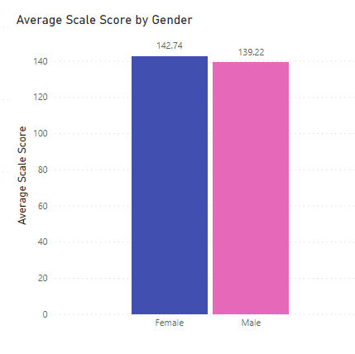
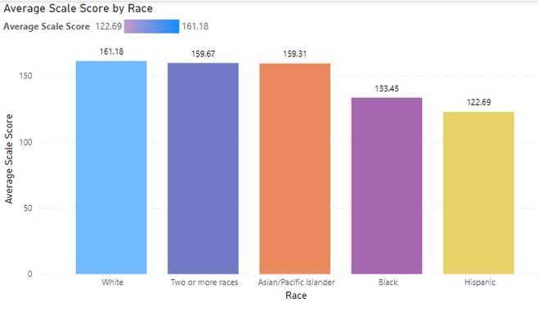
Figure 1
Figure 2

Slide 7
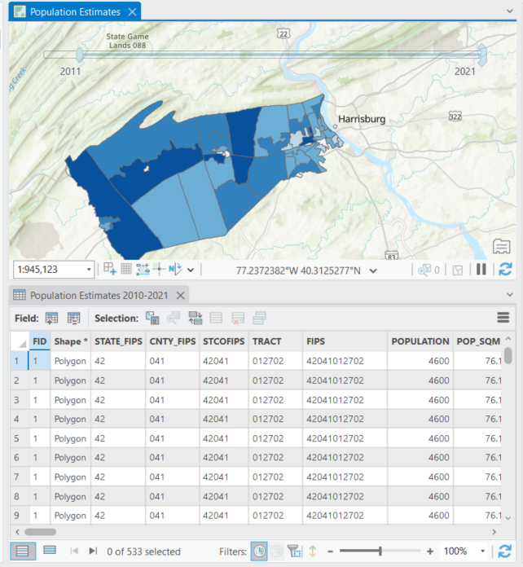
Figure 3

Slide 8
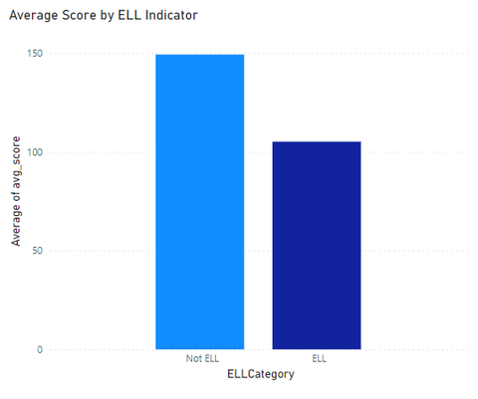
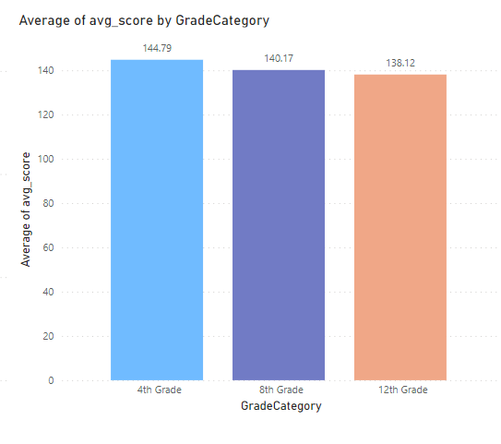
Figure 4
Figure 5

Slide 9
Implications
Stakeholders
Students, teachers.
Civic Literacy
By improving civics education, students may develop a deeper understanding of their rights and responsibilities as citizens, potentially leading to more informed decision-making and civic engagement.
Crime Prevention
Strengthening civics education programs could contribute to reducing juvenile delinquency rates by empowering youth with the knowledge and skills needed to navigate legal systems and make positive contributions to society.
Policy Implication
Implementing comprehensive civics education programs to equip students with practical legal knowledge and foster active civic engagement, potentially contributing to reducing juvenile delinquency rates.

Slide 10
Thank You!
Mini Project Presentation – Mai Nguyen

